Slide 1
Concurrency Zen
Marc Esher
cf.Objective() 2012
http://bit.ly/cfconcurrencyzen

Slide 2
I work on…
MXUnit
CFMongoDB
CFMetrics – Uses the Java Concurrency Framework
CFConcurrent – Helps YOU use the Java Concurrency Framework

Slide 3
I Hereby Promise…
To Mix Metaphors
To make senseless use of animated transitions
To say “reason about” at least 20 times
To prove that I suck at Photoshop
To teach you how to use parts of the Java Concurrency Framework (JCF) in ColdFusion

Slide 4
This Presentation is NOT About
Replacing CFThread for “fire-and-forget” operations
Using Scala, Clojure, or other JVM languages

Slide 5
This Presentation is NOT About
Twitter-scale message busses
NASDAQ-scale stock exchanges

Slide 6
This Presentation is About
Production Applications requiring:

Slide 7
This Presentation is About
Responsible
Safe
Testable
Manageable
Production-worthy Concurrency

Slide 8


Notes:
At a previous job, I had much success converting older, brittle ColdFusion applications into multi-threaded Java applications. It was during that time that I learned all about concurrency.
True story, In 2004 I wrote my first Java program that used concurrency. My first “concurrent” program didn’t use threads. Instead, I was firing up brand new JVM instances and passing command line arguments to it… from another java program.
I was stupid! I’ve learned a lot since then, and that’s what I’m here to talk about

Slide 9
history.start()

Slide 10
1995
Cold Fusion 1.0

Slide 11
1996
JDK 1.0 Released
Threads from the start
Notes:
Born from the Oak programming language, originally intended for programming smart appliances
http://en.wikipedia.org/wiki/Oak_(programming_language)

Slide 12
1998 (CF 3.1 / CF 4.0)
util.concurrent 1.0 Released
-- Doug Lea
Foundations of the JCF

Slide 13

1999 (CF 4.5)
Season 1

Slide 14
2002 (CF MX 6.0)
JSR 166 Expert Group Formation
Birth of java.util.concurrent
Notes:
2.3 What need of the Java community will be addressed by the proposed specification?
Low level threading primitives, such as synchronized blocks, Object.wait and Object.notify, are insufficient for many programming tasks. As a result, application programmers are often forced to implement their own higher level concurrency facilities. This results in enormous duplication of effort. Further, such facilities are notoriously hard to get right and even more difficult to optimize. The concurrency facilities written by application programmers are often incorrect or inefficient. Offering a standard set of concurrency utilities will ease the task of writing a wide variety of multithreaded applications and generally improve the quality of the applications that use them.
2.4 Why isn't this need met by existing specifications?
Currently, developers can use only the concurrency control constructs provided in the Java language itself. These are too low level for some applications, and are incomplete for others.
http://jcp.org/en/jsr/detail?id=166

Slide 15
2004 (CF MX 6.1)
J2sE 5.0 Released
Java Concurrency Framework (JCF) Introduced

Slide 16
2006 (CF 7.0.2)
“Java Concurrency in Practice” Published
--Brian Goetz
“Writing correct programs is hard; writing correct concurrent programs is harder.”
Notes:
First sentence of Brian Goetz’s “Java Concurrency in Practice”, the seminal work on the topic

Slide 17


Sith Ninja?

Slide 18
What’s the meaning of this?
13 years after CF 1.0
12 years after JDK 1.0
10 years after the birth of modern concurrency on the JVM
4 years after JCF introduced
2 years after JCiP demonstrates the difficulties of concurrency
……

Slide 19
2008
ColdFusion 8 Released
CFThread Introduced
Notes:
CFThread is the only concurrency abstraction available in ColdFusion. It is the lowest-level abstraction available. Threads are nearly universally shunned as too difficult to program directly; no sane programmer on the JVM would think of using threads, given the other options available

Slide 20
2012
14 Years Ago!
Java programmers knew Threads were too low-level

Slide 21

June 21, 2011
Mark Mandel commits JavaLoader patch
Enabling use of JCF in ColdFusion
http://www.flickr.com/photos/jeffcoughlin/452274536/

Slide 22
Real-World Concurrency
Let’s Pick Apples

Slide 23
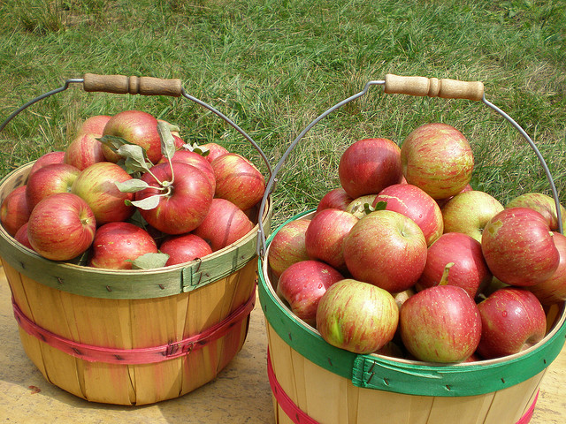
http://www.flickr.com/photos/29402381@N08/2819517029/

Slide 24
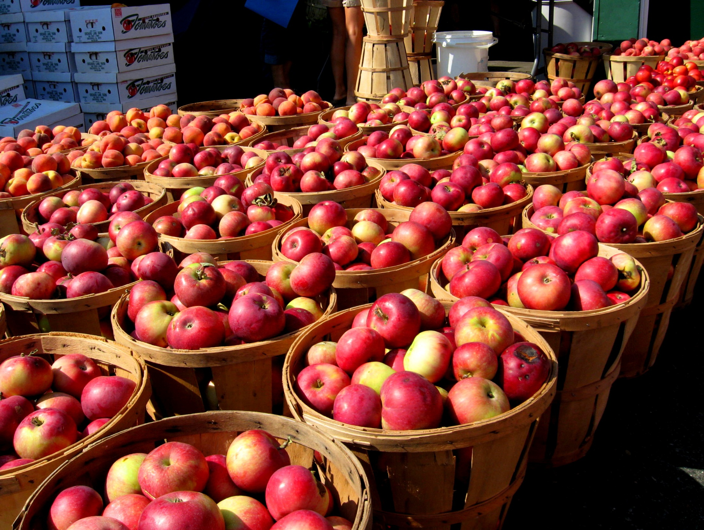
http://www.packetinsider.com/blog/nature/?cat=196
Notes:
http://www.packetinsider.com/blog/nature/?cat=196

Slide 25
Concurrency Tradeoffs
Higher cost?
Greater complexity?
Notes:
In this case, the more apples you pick, the faster you need to contend with the results…. More buckets, more trucks to haul, more drivers for the trucks, etc

Slide 26
ColdFusion Concurrency
CFThread is…
EASY!

Slide 27
CFThread is…
Hard to monitor
Hard to unit test
Hard to debug
Virtually Impossible to sanely post-process
Keyword: “sane”

Slide 28


Slide 29
Ommmmmmmm
Introducing:
Enlightened Concurrency in ColdFusion

Slide 30
Java Concurrency Framework
Thread-Safe Datatypes
--AtomicLong, AtomicInteger, etc
Thread-Safe Collections
--Queues, Dequeues, Maps, etc

Slide 31
Java Concurrency Framework
Executors
-- Classes that manage concurrency for you
Tasks (Callables)
--The code you write!

Slide 32
From the Inside-out
1. We’ll start with the code you write
2. Then we’ll see how the JCF runs your code
3. Finally, we’ll fetch the results

Slide 33
Tasks
The JCF is based on the concept of “Tasks”
Implement the “Callable” interface – has a call() method
In our case, a Task is a CFC instance
Tasks don’t share data (except that which is thread-safe)
Tasks “do stuff” and return a result
Tasks know nothing about concurrency – they know nothing about *how* they will be called
You “submit” your task to an “executor”
The executor runs the task and stores its result for later retrieval

Slide 34
Lifecycle of a Task
Create a “work queue” and a “completion queue”
Create a JCF CompletionService and configure it (very easy!)
Create and initialize multiple “Task” CFCs
“submit” tasks to the CompletionService
Periodically poll for completed tasks, where you can then post-process the results

Slide 35
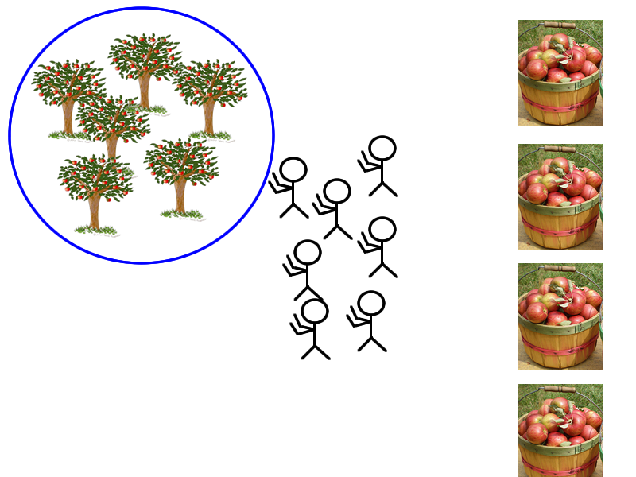
“Work Queue”
“Completion Service” →
“Completion Queue” →

Slide 36
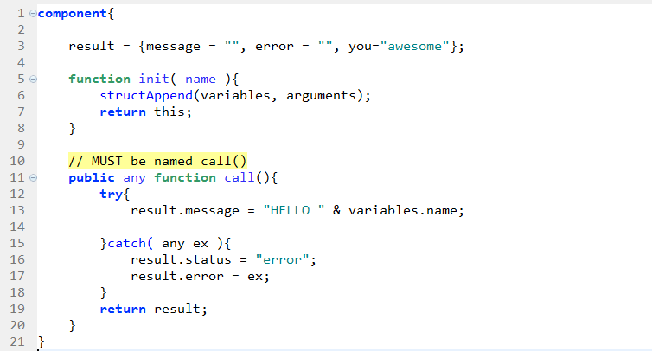
A Task CFC

Slide 37
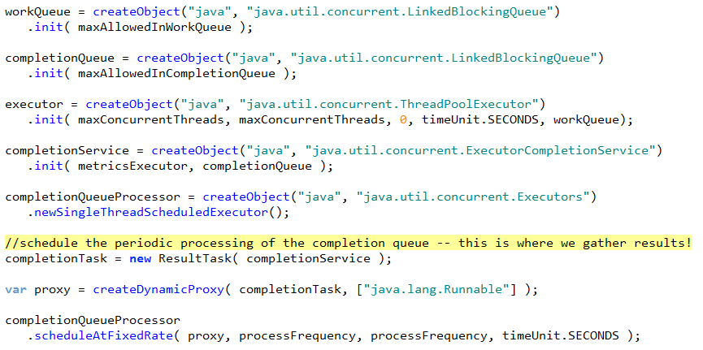
Work Queue

Slide 38
Completion Queue

Slide 39
Executor

Slide 40
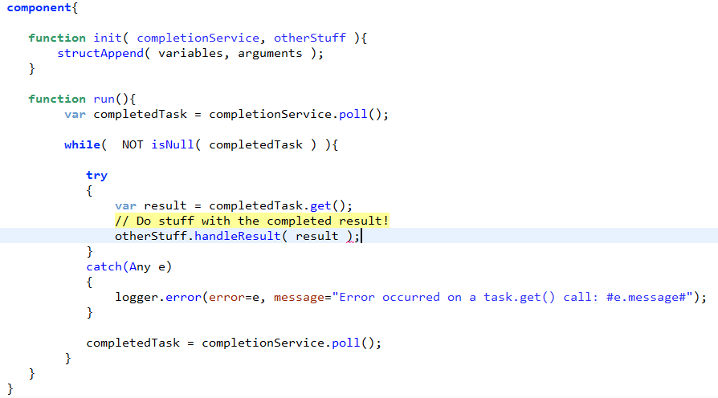
Task to process Completion Queue

Slide 41
Schedule the Completion Task

Slide 42
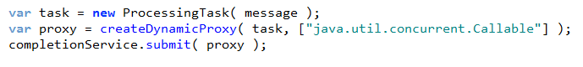
Submit Tasks to Executor

Slide 43
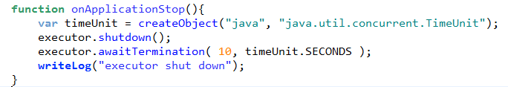
Shut it down on Application stop

Slide 44
JCF Example Extravaganza
Enough examples to nail home
How to use the JCF in ColdFusion
Why it’s so freakin’ awesome

Slide 45
Introducing CFConcurrent
Library that more easily exposes the JCF
Wraps up the common idioms / boilerplate
Provides lifecycle methods:
Start
Pause
Stop
Provides full access to all Java objects
Easy to use, easy to extend

Slide 46
Resources
http://docs.oracle.com/javase/tutorial/essential/concurrency/executors.html
http://docs.oracle.com/javase/7/docs/api/java/util/concurrent/package-summary.html
http://www.amazon.com/Java-Concurrency-Practice-Brian-Goetz/dp/0321349601/
http://www.vogella.de/articles/JavaConcurrency/article.html
http://www.ibm.com/developerworks/java/library/j-jtp02244/index.html

Slide 47
References
http://gee.cs.oswego.edu/dl/classes/EDU/oswego/cs/dl/util/concurrent/intro.html
http://en.wikipedia.org/wiki/ColdFusion#Adobe_ColdFusion_8
http://en.wikipedia.org/wiki/Java_concurrency
http://gee.cs.oswego.edu/dl/concurrency-interest/index.html
http://en.wikipedia.org/wiki/Java_version_history

